Slide 1

Mexico:
Where Opportunity Meets Profit
July 2025

Slide 2


Index
Investment & Trade
Competitive Advantages
Economic Integration
Plan Mexico
Incentives and Development Banking

Slide 3
Overview of
Mexico’s Economic Strength
Mexico ranks as the 15th largest economy globally, with a GDP of $1.69 trillion.¹ Despite global volatility, economic growth closed at 1.5% in 2024, with a forecast of 1.1% for 2026.²
The IMF highlights Mexico’s robust macroeconomic policies and resilience against global risks. Additionally, its strategic position makes it a key beneficiary of global supply chain shifts, attracting record Foreign Direct Investment (FDI) and driving sustainable growth.³
Inflation is projected to decline to 3.3% in 2025, remaining within Mexico's central bank (Banxico) target range of 3% ± 1%.⁴ As an independent institution, Banxico ensures stable monetary policy, fostering investor confidence through transparency and autonomy.
Total trade exceeded $1 trillion. Exports to the U.S. were 83% non-oil, with automotive products making up 35.7% of manufacturing exports.⁵
Pro-investment policies and trade agreements, including the Mexico-USA-Canada Agreement (USMCA) and the Comprehensive and Progressive Agreement for Trans-Pacific Partnership (CPTPP), bolster Mexico’s position as a nearshoring hub.
1/ Fondo Monetario Internacional. (2025). Base de datos del Informe sobre las Perspectivas de la Economía Mundial, abril de 2025. Recuperado de https://www.imf.org/external/datamapper/NGDPD@WEO/OEMDC/ADVEC/WEOWORLD
2/ OECD (2025), OECD Economic Outlook, Volume 2025 Issue 1: Tackling Uncertainty, Reviving Growth, No. 117, OECD Publishing, Paris, https://doi.org/10.1787/83363382-en .
3/ International Monetary Fund. Western Hemisphere Dept. "Mexico: 2024 Article IV Consultation and Review Under the Flexible Credit Line Arrangement-Press Release; Staff Report; and Statement by the Executive Director for Mexico", IMF Staff Country Reports 2024, 317 (2024), accessed January 3, 2025, https://doi.org/10.5089/9798400292620.002
4/ Banco de México. (2025, 6 de febrero). Anuncio de la decisión de política monetaria. https://www.banxico.org.mx/publications-and-press/announcements-of-monetary-policy-decisions/%7B2A312FE9-46E2-ECA2-18CA-E41525914605%7D.pdf
5/ Banco de México, "Balanza de productos manufacturados -no maquila-," accessed January 6, 2025, https://www.banxico.org.mx/SieInternet/consultarDirectorioInternetAction.do?sector=1&accion=consultarCuadroAnalitico&idCuadro=CA180&locale=es.

Slide 4

I. Investment & Trade

Slide 5
Foreign Direct
Investment Trends¹
Figure 1. Foreign Direct Investment Inflows to Mexico by Country, 1999 - Q1 2025 (Million USD)²
Country of Origin | Total FDI (1999 - Q1 2025 ) | %
United States | $337,640 | 43.7
Spain | $81,848 | 10.6
Canada | $58,811 | 7.6
Germany | $40,805 | 5.3
Japan | $39,389 | 5.1
United Kingdom | $22,557 | 2.9
Netherlands | $21,925 | 2.8
France | $13,234 | 1.7
Switzerland | $11,515 | 1.5
Italy | $8,612 | 1.1
Others | $136,832 | 17.7
Total | $773,168 | 100
11th-largest FDI recipient in the world
3rd among OECD member countries
4th in the Americas
2nd in Latin America
1/ United Nations Conference on Trade and Development. (2025). World Investment Report 2025: International investment in the digital economy. United Nations. https://unctad.org/publication/world-investment-report-2025
2/ Secretaría de Economía.

Slide 6
Foreign Direct
Investment Trends
A 3.1% increase compared with 2023, reaching a new all-time high.²
  In 2024, Mexico captured nearly one-fourth of all FDI in Latin America and the Caribbean.¹
37,613
(Million USD)
36,481
(Million USD)
  Mexico was the second-largest Mergers & Acquisitions market in Latin America in 2024, with a total of 44 transactions.¹
2023
2024
1/ CEPAL. (2025). La Inversión Extranjera Directa en América Latina y el Caribe 2025. https://repositorio.cepal.org/server/api/core/bitstreams/8bf7c3d9-f2f8-4ee2-a4e5-f4e6096a5879/content
2/Secretaría de Economía

Slide 7
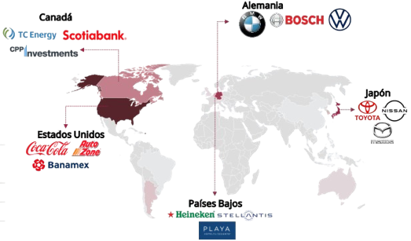
Foreign Direct
Investment Trends¹
As of year-end 2024, in million current dollars
The United States remains Mexico’s primary investment partner, accounting for 45% of total flows. For this period, Japan and Germany occupy the second and third places, respectively; both are long-standing trading partners in our country.
Figure 1. Top 5 Countries with the Highest FDI in Mexico
Country of origin | FDI 2024 | % | Change in position compared to 2023
Top 5 | 26,683 | 81%
United States | 16,513 | 45% | Same
Japan | 4,285 | 12% | 2
Germany | 3,788 | 10% | 2
Canada | 3,216 | 9% | 1
Netherlands | 1,881 | 5% | 3
1/ Secretaría de Economía, "Informe Estadístico sobre el Comportamiento de la Inversión Extranjera Directa en México (Tercer Trimestre de 2024)," published November 15, 2024, accessed January 6, 2025, https://www.gob.mx/cms/uploads/attachment/file/963441/Informe_Congreso_2024_3T.pdf.

Slide 8
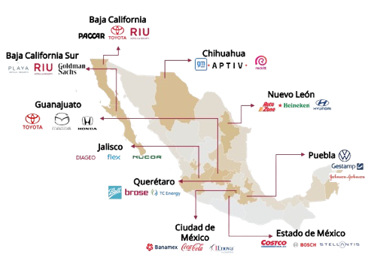
Foreign Direct
Investment Trends¹
As of year-end 2024, in million current dollars
Figure 1. Top 10 Entities with the Highest FDI in Mexico
Federal Entity | FDI 2024 | % | Change in position compared to 2023
Top 10 | 29,261 | 79%
1. Mexico City | 14,427 | 39% | Same
2. State of Mexico | 2,642 | 7% | 4
3. Baja California | 2,479 | 7% | 4
4. Nuevo Leon | 2,098 | 6% | 1
5. Chihuahua | 1,497 | 4% | Same
6. Guanajuato | 1,442 | 4% | 8
7. Baja California Sur | 1,353 | 4% | 4
8. Puebla | 1,168 | 3% | 16
9. Jalisco | 1,100 | 3% | 5
10. Queretaro | 1,055 | 3% | Same
1/ Secretaría de Economía, "Informe Estadístico sobre el Comportamiento de la Inversión Extranjera Directa en México (Tercer Trimestre de 2024)," published November 15, 2024, accessed January 6, 2025, https://www.gob.mx/cms/uploads/attachment/file/963441/Informe_Congreso_2024_3T.pdf.
8

Slide 9
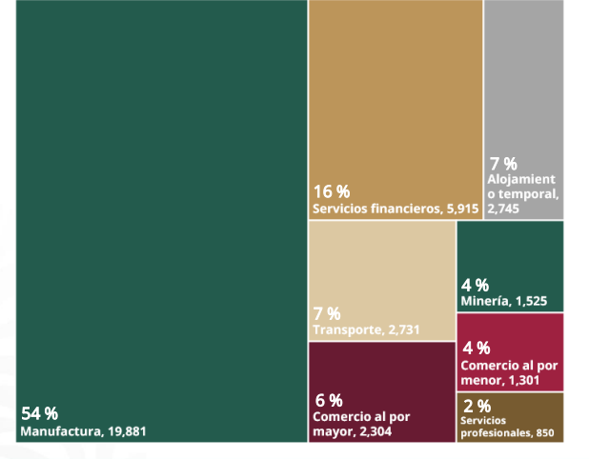
Foreign Direct
Investment Trends
As of year-end 2024, in million current dollars
Mexico is a hub for specialized manufacturing that requires increasing capital as demand grows in its industries, both nationally and internationally.
54% of FDI corresponds to the manufacturing sector, with the following main industries:
Transportation equipment (50%)
Beverages and tobacco (20%)
Computer equipment (9%)
Chemical (6%)
Basic metal industries (4%)
16%
Financial services
5,915
7% Temporary accommodation 2,745
4% Mining 1,525
7% Transportation2,731
4%
Retail
1,301
54%
Manufacturing
19,881
6%
Wholesale
2,304
2%
Professional Services
850
1/ Secretaría de Economía. (2025, 25 de febrero). Inversión extranjera directa en México: cifras preliminares 4T 2024. https://www.gob.mx/cms/uploads/attachment/file/980231/20250225_IED_4T_2024_Versi_n_p_blica_VF.pdf

Slide 10
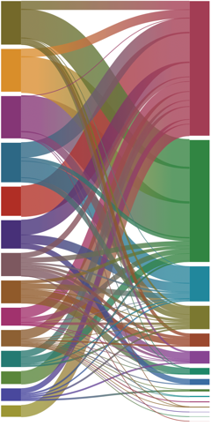
Leading Destination for Digital-Focused FDI¹
Figure 1. Digital FDI Announcements in Latin America
(2020–2024, Million USD)
Companies
Destination country
Amazon 3,782
  Mexico is the leading destination for digital-focused FDI in Latin America, capturing 32% of all project announcements from 2005 to 2024.
CloudHQ 3,720
11,700
Mexico
Microsoft 3,676
Aligned Energy 3,439
Zayo Group 2,541
10,598 Brazil
Tower One Wireless 2,465
Telefónica 2,017
América Móvil 1,985
3,053 Colombia
Huawei Technologies 1,562
2,030 Chile
Samsung 1,433
1,143 Argentina
Digital Reality 1,409
1,095 Peru
Hangzhou Gene Solar Industries 1,100
580 Costa Rica
516 Ecuador
Quanta Computer 1,000
196 Paraguay
101 Panama
1/ CEPAL. (2025). La Inversión Extranjera Directa en América Latina y el Caribe 2025. https://repositorio.cepal.org/server/api/core/bitstreams/8bf7c3d9-f2f8-4ee2-a4e5-f4e6096a5879/content

Slide 11
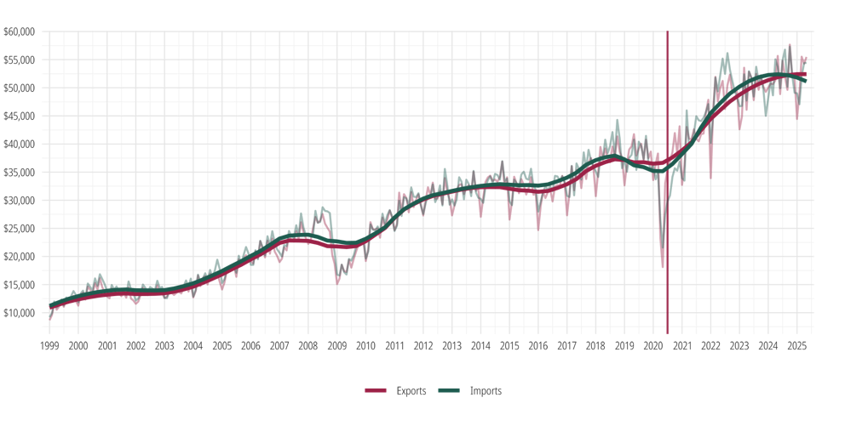
Mexico is an
Exporting Powerhouse¹
Figure 1. Trade Balance (Million USD, 1999 – May 2025)
This consistent export growth has positioned Mexico as the
10th largest exporter worldwide
USMCA
>600 Billion USD Exports (2024)
>1,000 Billion USD Total Trade (2021 - 2024)
1/ Instituto Nacional de Estadística y Geografía (INEGI). “Balanza comercial de mercancías de México”, Banco de Información Económica. Disponible en: https://www.inegi.org.mx/app/tabulados/default.html?nc=452&idrt=8&opc=t (consulta: 9 de julio de 2025).

Slide 12







… and a Leader
in Key Sectors
Automotive¹ | 3rd largest exporter worldwide
Medical Devices¹ | 4th largest exporter worldwide
Agribusiness² | 7th largest exporter worldwide
Metal mechanics¹ | 10th largest exporter worldwide
Electronic¹ | 10th largest exporter worldwide
Aerospace³ | 12th largest market worldwide
Pharmaceutical⁴ | 12th largest market worldwide
Processed food⁵ | 9/10 leading companies have a presence in Mexico
1/ Secretaría de Economía, “Balance económico 2024: Industria, comercio e inversiones,” accessed January 7, 2025, https://www.gob.mx/se/prensa/balance-economico-2024-industria-comercio-e-inversiones?idiom=es
2/ Secretaría de Agricultura y Desarrollo Rural, “México, estrella productora y exportadora,” accessed January 7, 2025, https://www.gob.mx/agricultura/es/articulos/mexico-estrella-productora-y-exportadora
3/ Federación Mexicana de la Industria Aeroespacial, A.C., “Conoce la Industria,” accessed January 7, 2025, https://femiamx.com/#!/-conoce-la-industria-2/
4/ Sistema de Cuentas Nacionales, INEGI., “Industria Farmacéutica,” accessed January 7, 2025, https://www.gob.mx/cms/uploads/attachment/file/119065/Sector_Industria_Farmaceutica.pdf
5/ Secretaría de Agricultura y Desarrollo Rural, “Principales exportaciones de México,” accessed January 7, 2025, https://www.gob.mx/agricultura/articulos/principales-exportaciones-de-mexico#:~:text=M%C3%A9xico%20cuenta%20con%20caracter%C3%ADsticas%20privilegiadas,al%20campo%20como%20un%20%23OrgulloDeM%C3%A9xico

Slide 13
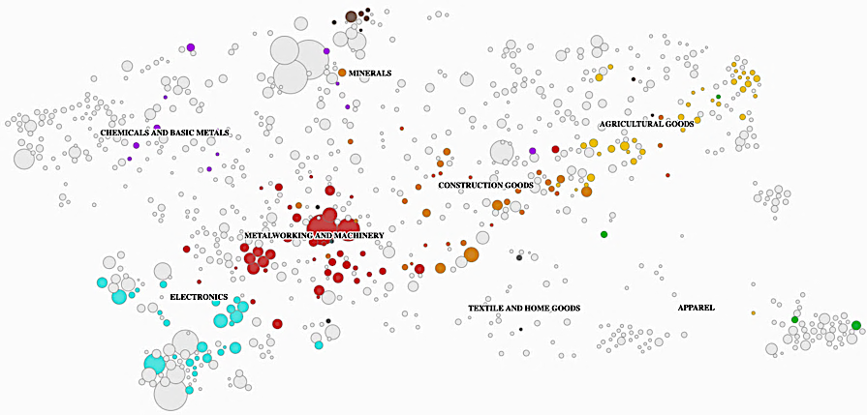
Mexico’s Economy has a
Strong Base in Manufacturing
with Potential for Higher Complexity Growth¹
Mexico's export economy is anchored in high-complexity clusters like metalworking and electronics, reflecting a robust industrial base.
Proximity to nearby products in chemicals and pharmaceuticals signals opportunities to expand into other complex sectors.
Colored dots represent products where Mexico has a Revealed Comparative Advantage (RCA > 1), showcasing sectors with proven global competitiveness.
1/ Harvard Growth Lab, "Mexico Product Space," accessed January 6, 2025, https://atlas.hks.harvard.edu/explore/productspace?exporter=country-484.

Slide 14
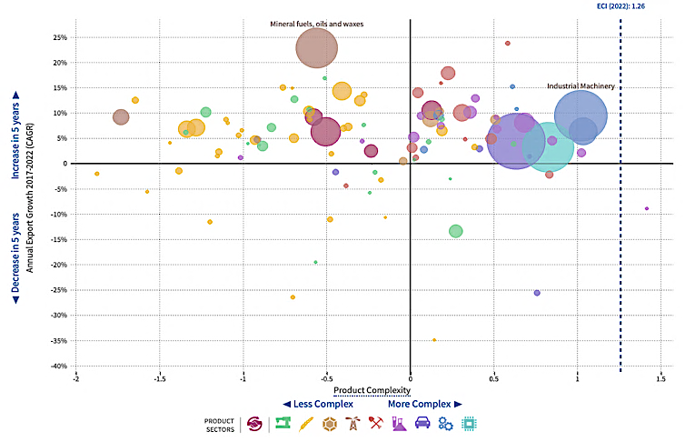
Mexico has Advanced in
Global Economic Complexity¹
Rising from 30th in 1995 to 21st in 2022
High-growth, high-complexity sectors, like industrial machinery, showing strong growth.
Large trade value with potential for further growth but moderate complexity.
1/ Harvard Growth Lab, "Mexico Growth Dynamics," accessed January 6, 2025, https://atlas.hks.harvard.edu/countries/484/growth-dynamics.

Slide 15
II. Competitive Advantages

Slide 16
Mexico on the Rise:
A Confident Choice for Global Investors
Mexico ranks 6th among emerging markets in the 2024
Foreign Direct Investment Confidence Index.¹
Geographic proximity to the United States and Canada, combined with the benefits of being a USMCA member, places Mexico in a unique position to attract investment.
A robust industrial infrastructure and a wide network of trade agreements that connect Mexico to diverse global regions.
Skilled, young workforce
Macroeconomic and
political stability
Strong domestic market
1/ Kearney. (2025). Índice de confianza en la inversión extranjera directa 2025. Recuperado de https://www.kearney.com/service/global-business-policy-council/foreign-direct-investment-confidence-index/2025-full-report

Slide 17





Youthful
and Skilled Workforce¹
10°
+60M
Top 10
175K
29y
10th most populous country.
(>130M people)
Over 60 million economically active individuals
Median age of
29 years
Among top 10 OECD countries for STEM graduates
+175K STEM
graduates in 2023
(+70% in engineering, manufacturing, and construction)
Within the OECD, Mexico ranks 1st in technical graduates and 4th in professional graduates.
1/ Secretaría de Economía, Subsecretaría de Comercio Exterior, El Poder del Talento Mexicano: Transformando regiones,Ciudad de México, 2024, accessed January 6, 2025, https://www.gob.mx/cms/uploads/attachment/file/947099/Talento_mexicano_2da_edicion.pdf.

Slide 18
Youthful
and Skilled Workforce¹
Figure 1. Technical Graduates by Country (Million USD)
Out of the 700 technical programs offered at the high school level, 269 are related to STEM disciplines.
1/ Secretaría de Economía, Subsecretaría de Comercio Exterior, El Poder del Talento Mexicano: Transformando regiones,Ciudad de México, 2024, accessed January 6, 2025, https://www.gob.mx/cms/uploads/attachment/file/947099/Talento_mexicano_2da_edicion.pdf.

Slide 19




Fueling the Future:
Mexico’s Innovation in Action
Mexico has 50 research centers and laboratories focused on innovation in industries such as electricity and electronics.
Energy: Innovation for
the energy transition
Semiconductors: Technological
foundation for advanced manufacturing
Institutions like the National Institute of Astrophysics, Optics and Electronics (INAOE) and the Center for Research in Advanced Materials (CIMAV) lead cutting-edge projects in semiconductors and advanced materials.
Electromobility: Innovation for the automotive industry.
Cybersecurity: Protection of
digital and productive infrastructure
The central-southern and eastern regions have the highest number of graduates in STEM fields, with 72,456 professionals, followed by the western region, with 35,137.
1/ Secretaría de Economía, Subsecretaría de Comercio Exterior, El Poder del Talento Mexicano: Transformando regiones,Ciudad de México, 2024, accessed January 6, 2025, https://www.gob.mx/cms/uploads/attachment/file/947099/Talento_mexicano_2da_edicion.pdf.

Slide 20




Harnessing
Renewable Energies
to Drive a Sustainable Future
Mexico aims to reach 45% clean electricity by 2030 through the installation of 46 GW in new solar and wind projects.¹
Between 2024 and 2030, Mexico will add 194 transmission projects and 135 distribution projects, including 5,719 km of new transmission lines, to strengthen its energy infrastructure and support growing demand.¹
Mexico has an annual average solar insolation of approximately 5.5 kWh/m²/day, making it one of the countries with the greatest potential for solar energy generation in the world.²
Mexico possesses exceptional wind resources, particularly in the Isthmus of Tehuantepec, one of the world's windiest regions with average speeds of 8–10 m/s. The country has the potential to double its current installed wind capacity.³
16%
of total capacity
added by 2027
solar
20%
of total capacity
added by 2027
wind
1/ Ember (2025). Renewables: Mexico’s Energy Security. Ember Climate. Disponible en: https://ember-climate.org
2/ Secretaría de Energía, "Programa de Desarrollo del Sistema Eléctrico Nacional (PRODESEN) 2024-2038," accessed January 6, 2025, https://www.cenace.gob.mx/Docs/16_MARCOREGULATORIO/Prodecen/20%202024-2038%20Cap%C3%ADtulos%201%20al%206.pdf.
3/ Asociación Mexicana de Energía Eólica, "Inicio," accessed January 6, 2025, https://amdee.org/es_es/home-2/.

Slide 21





Robust
Infrastructure Network
118
Ports and Terminals
+27,500km
Railway Network
+189,000km
Road Network
50
Custom Offices
(18 with the U.S.)
80
Airports
(65 International)
1/ Secretaría de Economía, Invierte en México: El momento mexicano, published September 2024, accessed January 6, 2025, https://www.gob.mx/cms/uploads/attachment/file/947098/Inversion_2da_version_ESP_a.pdf.

Slide 22
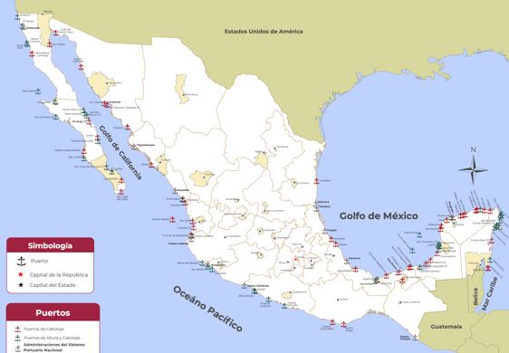
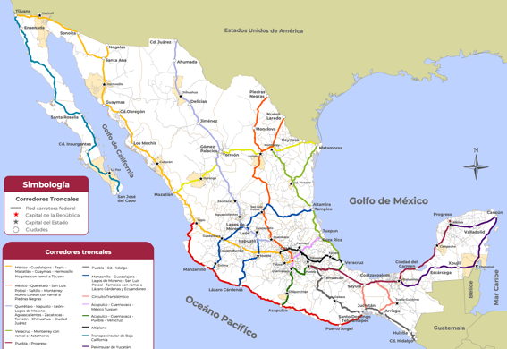




Robust
Infrastructure Network¹
Map 1. Mexico’s Port System
Map 2. National Highway Network and Trunk Corridors
Gulf of Mexico
Gulf of Mexico
Pacific Ocean
Pacific Ocean
1/ Secretaría de Infraestructura, Comunicaciones y Transportes. (2023). Atlas del Sector Infraestructura, Comunicaciones y Transportes 2023. Dirección General de Planeación. https://www.sct.gob.mx/planeacion/cartografia/atlas-del-sector/

Slide 23
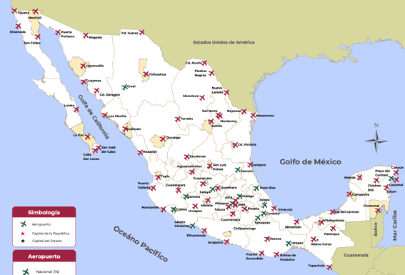
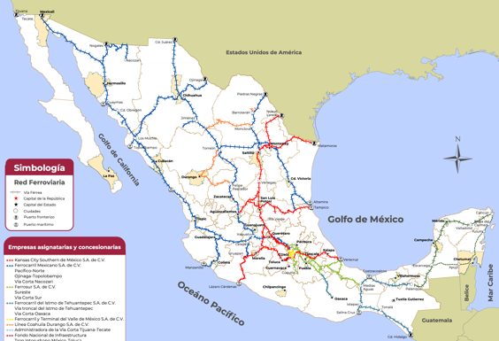




Robust
Infrastructure Network¹
Map 1. Mexico’s Airport System
Map 2. Mexico’s Railway System
Gulf of Mexico
Gulf of Mexico
Pacific Ocean
Pacific Ocean
1/ Secretaría de Infraestructura, Comunicaciones y Transportes. (2023). Atlas del Sector Infraestructura, Comunicaciones y Transportes 2023. Dirección General de Planeación. https://www.sct.gob.mx/planeacion/cartografia/atlas-del-sector/

Slide 24
Strengthening Security
to Foster Investment Confidence
Consolidating Mexico’s National Guard to ensure law enforcement efficiency
Addressing root causes of violence
Enhancing intelligence and investigation capabilities
Ensuring seamless coordination between federal and state entities
Key pillars
Decrease in homicides¹
-25.8%
Between September 2024
and May 2025
Reducing organized crime and high-impact offenses
Neutralizing violence generators and dismantling criminal networks
Focused attention on high-incidence zones
Strengthening actions to apprehend key violence instigators in each region
Objectives
1/ Presidencia de la República, "Versión estenográfica: Presidenta destaca reducción de 19 homicidios dolosos diarios de septiembre 2024 a marzo 2025, gracias a la Estrategia Nacional de Seguridad," accessed March 31, 2025, https://www.gob.mx/presidencia/prensa/presidenta-destaca-reduccion-de-19-homicidios-dolosos-diarios-de-septiembre-2024-a-marzo-2025-gracias-a-la-estrategia-nacional-de-seguridad?idiom=es

Slide 25




Strengthening Security
to Foster Investment Confidence
Mexico has implemented various strategies to strengthen security, creating a more stable investment environment:
Public perception of safety
Business security and confidence
Strategic security protection
Financial investigation and intelligence
Decrease in perceived crime-related insecurity from 73.7% in 2018 to 61.7% in 2024.¹
Downward trend in states with the highest perceived crime-related insecurity.²
As of May 2025, federal crimes decreased by 39.5%, while common law crimes dropped by 44.3% in theft and 33% in firearm discharges.³
39% of companies feel safer than the previous year (vs. 17% in 2023).⁴
This improvement is related to an increase investments in internal security by the private sector. ⁴
80% coverage of the Tourist Police in Mexico City.⁵
217,000 Armed Forces personnel deployed throughout the country. ³
143,169 state and municipal police officers are reinforcing security in different regions.⁶
Creation of the National System of Investigation and Intelligence to improve institutional coordination.
12 intelligence and investigation units operating in strategic areas.
Collaboration between the FIU, FBI, and FinCEN to identify Business Email Compromise (BEC) fraud.
1/ ENSU 2018 and 2024, accessed March 31, 2025, shttps://www.inegi.org.mx/app/saladeprensa/noticia/9587 and chrome-extension://efaidnbmnnnibpcajpcglclefindmkaj/https://www.inegi.org.mx/contenidos/programas/ensu/doc/ensu2018_diciembre_presentacion_ejecutiva.pdf
2/ Presidencia de la República, Informe de Seguridad 25 de marzo de 2025, accessed March 31, 2025, https://www.gob.mx/presidencia/es/articulos/version-estenografica-conferencia-de-prensa-de-la-presidenta-claudia-sheinbaum-pardo-del-25-de-marzo-de-2025
3/ Presidencia de la República, Informe de seguridad 9 de enero 2025, accessed March 31, 2025, https://www.gob.mx/presidencia/articulos/version-estenografica-conferencia-de-prensa-de-la-presidenta-claudia-sheinbaum-pardo-del-9-de-enero-de-2025-387640
4/ Sondeo de seguridad Empresarial AMCHAM, accessed March 31, 2025, https://amcham.org.mx/files/Envios/Eventos24/Sondeo/KitAliados/10o_Sondeo_de_Seguridad_Empresarial_AMCHAM.pdf
5/ Comunicado 2940 Policía Turística noviembre 2022, accessed March 31, 2025, https://www.ssc.cdmx.gob.mx/comunicacion/nota/2940-la-policia-turistica-de-la-ssc-celebro-su-tercer-aniversario-de-brindar-auxilio-visitantes-nacionales-y-extranjeros-en-la-ciudad-de-mexico#:~:text=Asimismo%2C%20destac%C3%B3%20que%20la%20unidad,la%20ciudad%3A%20centro%2C%20sur%20y
6/ Censo Nacional de Seguridad Pública Estatal, accessed March 31, 2025, https://www.inegi.org.mx/programas/cnspe/2024/

Slide 26
III. Economic Integration

Slide 27
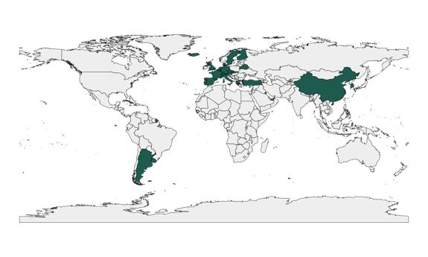
30 Bilateral Investment
Treaties (BIT) with 31 Countries¹
Figure 1. Countries with a BIT with Mexico (2025)
BITs are international treaties designed with the purpose of promoting international investment flows and providing certainty to the operations carried out by foreign investors.
Key Benefits of BITs
Level playing field for competition.
Legal protection for investors and investments.
Guaranteed control over investments.
Investor-State dispute resolution mechanism.
  Mexico has the 3rd highest number of active
  BITs in the Americas, leading North America
  and just behind Chile and Argentina.
Argentina, Austria, Bahrain, Belarus, Belgium, China, Cuba, Czech Republic, Denmark, Finland, France, Germany, Greece, Hong Kong, Iceland, Italy, Kuwait, Luxembourg, Netherlands, Portugal, Singapore, Slovakia, South Korea, Spain, Sweden, Switzerland, Trinidad and Tobago, Turkey, United Arab Emirates, United Kingdom, and Uruguay.
1/ United Nations Conference on Trade and Development, "International Investment Agreements Navigator," accessed January 6, 2025, https://investmentpolicy.unctad.org/international-investment-agreements/by-economy.

Slide 28
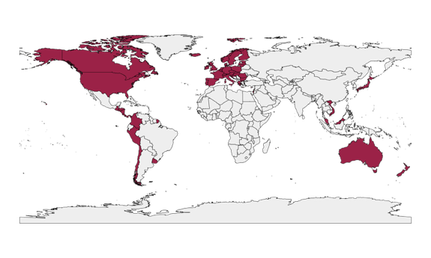
Mexico's Free Trade
Agreements (FTAs)
14 free trade agreements providing
preferential access to 52 countries¹
Figure 1. Countries with FTA with Mexico (2025)
Key Benefits of FTAs
Connects Mexico to broader markets with reduced trade barriers.
Enhances competitiveness for Mexican exports.
Grants access to a wider variety of products and services.
Promotes technology transfer and collaboration across sectors.
Strengthens Mexico’s role in global value chains.
Australia, Austria, Belgium, Brunei Darussalam, Bulgaria, Canada, Chile, Colombia, Costa Rica, Croatia, Cyprus, Czech Republic, Denmark, El Salvador, Estonia, Finland, France, Germany, Greece, Guatemala, Honduras, Hungary, Iceland, Ireland, Israel, Italy, Japan, Latvia, Liechtenstein, Lithuania, Luxembourg, Malaysia, Malta, Netherlands, New Zealand, Nicaragua, Norway, Panama, Peru, Poland, Portugal, Romania, Singapore, Slovakia, Slovenia, Spain, Sweden, Switzerland, United Kingdom, United States, Uruguay, and Vietnam.
1/ Secretaría de Economía, "Invierte en México: El momento mexicano," published September 2024, accessed January 6, 2025, https://www.gob.mx/cms/uploads/attachment/file/947098/Inversion_2da_version_ESP_a.pdf.

Slide 29
Mexico's Free Trade
Agreements (FTAs)
Preferential access to 1.3 billion consumers¹
Details for Major FTAs²
USMCA [enforced in 2020]
(3 countries)
  $1.6 trillion USD in trade (2023)
  509 million consumers
CPTPP [enforced in 2018]
(11 countries across 3 continents)
  $78 billion USD in trade (2021)
  697 million consumers
EFTA [enforced in 2000]
(5 countries)
  $45 billion USD in trade (2022)
  147 million consumers
MEXICO-EU FTA [enforced in 2000]
(27 countries)
  $89 billion USD in trade (2023)
  481 million consumers
1/ Secretaría de Economía, "Invierte en México: El momento mexicano," published September 2024, accessed January 6, 2025, https://www.gob.mx/cms/uploads/attachment/file/947098/Inversion_2da_version_ESP_a.pdf.
2/ Information on consumer by FTA comes from: U.S. Census Bureau, "International Database," accessed January 6, 2025, https://www.census.gov/datatools/demo/idb/#/table?dashboard_page=country&COUNTRY_YR_ANIM=2025&CCODE_SINGLE=*AY&subnat_map_admin=ADM1&CCODE=*AY,**&menu=tableViz&TABLE_YEARS=2025&TABLE_USE_RANGE=N&TABLE_USE_YEARS=Y&TABLE_STEP=1&TABLE_ADD_YEARS=2025&quickReports=CUSTOM&CUSTOM_COLS=POP.

Slide 30

The USMCA Heralds
a New Era of Trade and
Business in North America
  Regional value chains in North America are highly integrated and essential to manufacturing. On average, auto parts cross regional borders 8 times before a vehicle is completed.¹
$3million USD
traded every minute in North America.²
1/ Industria Nacional de Autopartes. (2025). The other side of the coin. https://ina.com.mx/wp-content/uploads/2025/02/The-other-side-of-the-coin-V.F.pdf
2/ Center for Strategic and International Studies, "The USMCA Strategic Initiative," accessed January 6, 2025, https://www.csis.org/programs/americas-program/usmca-strategic-initiative.

Slide 31
The USMCA Establishes
Innovative Rules to Address
21st-Century Challenges
Streamlines customs procedures, reducing processing times, increasing transparency, and enhancing cross-border efficiency.
Facilitates SME access to international markets through digital trade and reduced compliance costs.
Strengthens labor and environmental standards to ensure sustainable growth and responsible practices.
Supports integrated regional supply chains in key industries like semiconductors, automotive, and agriculture.
Establishes a robust framework for data protection, e-commerce, and technology-driven trade.
Provides a transparent and reliable system for resolving trade disputes.
1/ Center for Strategic and International Studies, "The USMCA Strategic Initiative," accessed January 6, 2025, https://www.csis.org/programs/americas-program/usmca-strategic-initiative.

Slide 32
Mexico is the
Top U.S. Import Partner
Figure 1. Market Share of Total US Imports (Top 3 Countries)
NAFTA
China enters WTO
USMCA
1/ U.S. Census Bureau, "Foreign Trade: Data - Historical Series," accessed July ,2025, https://www.census.gov/foreign-trade/statistics/historical/index.html.

Slide 33
Mexico is the
Top U.S. Import Partner
Mexico's import share grew significantly from 8% (49,493 million USD) in 1994 to 15% (505,523 million USD) in 2024. This represents an 921% increase in the value of imports. Mexico overtook Canada in 2019 and became the top U.S. import source in 2023.
Although the value of imports from Canada increased by 221% from 1994 to 2024, Canada’s import share declined from 19% (128,406 million USD) in 1994 to 13% (411,887 million USD) in 2024, due to the growing prominence of Mexico and China.
China's import share surged from 11% in 2002 (the year it entered the WTO) to a peak of 22% in 2017 (+100%). However, trade tensions and diversification efforts caused China's share to drop sharply to 13% in 2024.
1/ U.S. Census Bureau, "Foreign Trade: Data - Historical Series," accessed July, 2025, https://www.census.gov/foreign-trade/statistics/historical/index.html.

Slide 34
IV. Plan Mexico

Slide 35
Plan Mexico:
A Roadmap to Industrial
Transformation by 2030
  Develop a long-term strategy for regional development.
Promote nearshoring to attract global supply chains.
Boost national and regional production through import substitution.
Relaunch the "Made in Mexico" program.
Create high-quality jobs in manufacturing and services.
Strengthen local supply chains with higher value-added contributions.
Advance regional development through focused industrial and wellbeing hubs.
  KEY OBJECTIVES
  2030 GOALS
  Top 10 global economy.
  Over 25% investment-to-GDP ratio by 2025, 28% by 2030.
  1.5 million jobs in strategic industries.
  50% of public procurement sourced from Mexican industries, with increased domestic content across key sectors.
Reduce approval timelines for investment processes from 2.6 years to 1 year by cutting 50% of bureaucratic steps.
Promoting environmental sustainability through initiatives like water reuse and clean energy adoption.

Slide 36
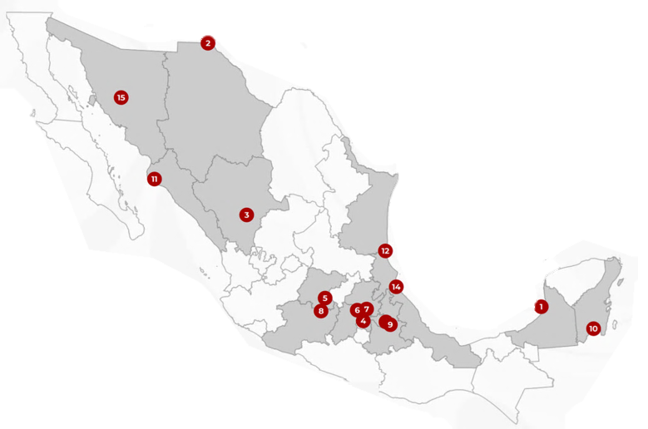
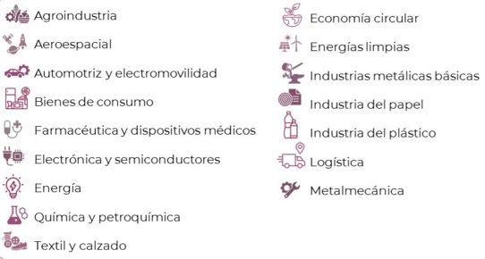
Regional Growth
Through New Strategic Poles
Strategic Sectors
Agrobusiness
Circular economy
Aerospace
Clean Energy
Automotive and electromobility
Basic metals
Consumer goods
Consumer goods
Paper
Pharmaceuticals and medical devices
Plastics
Semiconductors
Logistics
Energy
Metalworkings
Chemicals and petrochemicals
Textiles and footwear
Why these industries?
Expansion of existing sector
New productive activities
Substitution of industrial imports

Slide 37








Strategic Poles and
Key Industries for Growth
Development Pole |  | Sectors
1 | Seybaplaya, Campeche
2 | Juarez, Chihuahua
3 | Durango, Durango
4 | Nezahualcoyotl, State of Mexico
5 | Celaya, Guanajuato
6 | Tula, Hidalgo
7 | AIFA, Hidalgo
Development Pole |  | Sectors
8 | Morelia, Michoacan
9 | Ciudad Modelo, Puebla
10 | Chetumal, Quintana Roo
11 | Topolobampo, Sinaloa
12 | Altamira, Tamaulipas
13 | Huamantla, Tlaxcala
14 | Tuxpan, Veracruz
15 | Hermosillo, Sonora

Slide 38
Investment in Industrial Parks¹
Figure 1. Investment in Industrial Real Estate (2023–2025)
(million USD)
6,140
5,476
12.1%
103 new
industrial parks under construction
5,148
6.4%
Over 21.5 million square meters of identified land, currently in various stages of development.
2023
2024
2025
Investment in the development of new industrial parks, including the construction of facilities within them.
Investment in the development of existing industrial parks, including the construction of facilities within them.
Investment in the development and/or construction of new standalone industrial buildings (outside of industrial parks).
Investment in other development and construction concepts related to industrial real estate.
1/ AMPIP. (2025, junio). Forjando el futuro: La inversión en parques industriales en México. Asociación Mexicana de Parques Industriales Privados (AMPIP). https://www.ampip.org.mx/storage/es/AMPIP%20Forjando%20el%20futuro%2016062025.pdf

Slide 39
Public Investment
Supporting Plan Mexico
Sector | Commitment | Note
Energy | 23.4 billion USD for electricity generation, transmission and distribution infrastructure. | Achieve 45% clean energy in the national grid.
Oil & Gas (Pemex) | 17.3 billion USD of avg. annual investment. | Boost domestic oil and gas production and expand refining capacity.
Water | + 1 billion USD for hydrological projects by 2025. | Rehabilitate waterways and modernize irrigation systems for 200,000 hectares of farmland.
Infrastructure | + 3,000 km of new railways for freight and passenger use. | Enhance connectivity and modernize transportation networks to support economic growth.
Public Housing | 25.65 B USD to construct 1 million homes. | Improve access to housing and address the growing demand for affordable living spaces.

Slide 40
V. Incentives and Development Banking

Slide 41
A Quick Guide
to Mexican Taxes
Tax Jurisdiction | Tax Name | Description | Tax Rate
Federal | Value-Added Tax (IVA) | Flat ax on the sale of goods and services | 16%
 | Income Tax (ISR) – Individuals | Progressive tax on personal income | 1.92%-35%
 | Income Tax (ISR) – Industries | Flat tax on corporate profits | 30%
 | Special Tax on Production and Services (IEPS) | Excise tax on specific goods like alcohol, tobacco, and fuel | Varies by product (8%-50%)
 | General Import Tax (IGI) | Tax on imported goods | Varies by product
State | Payroll Tax (ISN) | Tax on salaries paid by employers | Varies by state (1%-3%)
Municipal | Property Tax | Tax on real estate owned by businesses | Varies by municipality
 | Rights for Utility Fees | Fees for services like water and waste management | Varies by municipality

Slide 42
Key Programs Driving
Manufacturing Competitiveness:
PROSEC
Aimed at companies manufacturing specific goods, allowing them to import raw materials, machinery, and components with preferential tariffs, regardless of whether the final product is for export or the domestic market.¹
Who is it for: Manufacturers in key sectors such as automotive, electronics, and aerospace.
Why it matters: Enables cost savings on production inputs, boosting profitability and encouraging investment in strategic sectors.
Key benefits: Reduced import duties on inputs and machinery.
1/ PROSEC https://www.snice.gob.mx/cs/avi/snice/progfom.prosec.acercade.html

Slide 43
Key Programs Driving
Manufacturing Competitiveness:
IMMEX PROGRAM
Designed for companies that temporarily import goods to perform industrial or service
processes, including manufacturing, transformation, repair, or export activities.¹
Who is it for: Companies involved in export-focused manufacturing or services.
Why it matters: Helps lower operating costs and improve competitiveness for businesses exporting from Mexico.
Key benefits:
  100% exemption from General Import Tax (IGI).
  Reduced compensatory fees (if applicable).
Mexico is updating its IMMEX Program to launch IMMEX 4.0, integrating Value Added Tax (IVA) and Special Tax Certification into a single export manufacturing procedure. This reform cuts new company startup times by 50% and expands eligibility to additional intangible industries.
1/ IMMEX Program https://www.snice.gob.mx/cs/avi/snice/progfom.immex.acercade.html

Slide 44
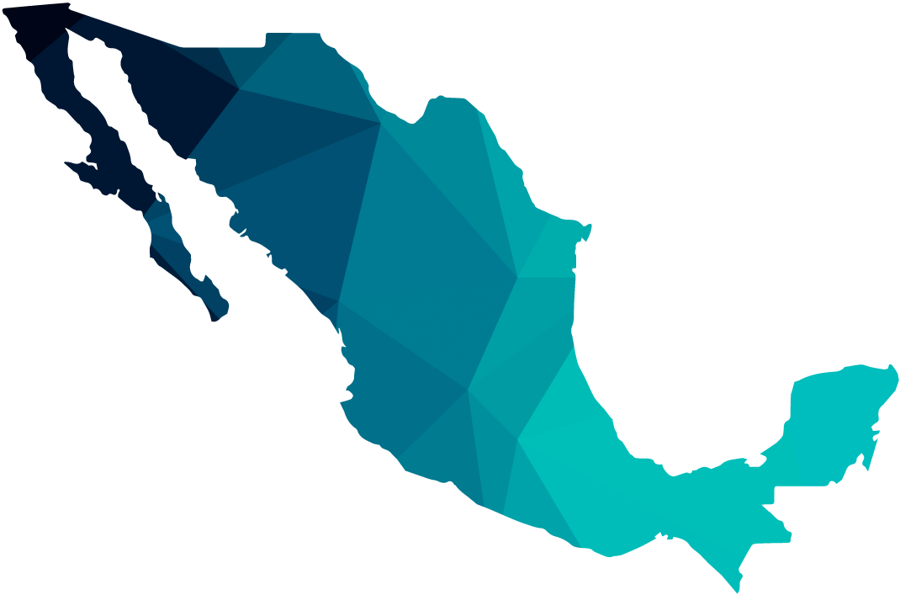
Strategic Tax Incentives
for Investment and Nearshoring
Free Zones: Strategic Border Incentives
Special tax and investment benefits for companies operating near
Mexico’s northern border with the U.S. and southern border with
Guatemala and Belize.
Key Benefits:
  50% reduction in Value Added Tax (IVA) (from 16% to 8%).
  Tax credit equivalent to one-third of Income Tax (ISR) incurred during the year or in provisional payments.

Slide 45
Other Incentives
under Plan Mexico¹
Immediate Investment Deduction for Income Tax (ISR)
  Applies to new fixed assets (excluding furniture, office equipment, combustion engine vehicles, armored vehicles, etc.)
  Must be used for the first time in Mexico
  Must remain in operation for at least 2 years
  Deadline for acquisition: September 30, 2030
  Good-based depreciation percentages: 2025–2026: 41%–91%
    2027–2030: 35%–89%
Additional 25% Deduction for Income Tax (ISR)
Applicable to increased spending on training of formal employees registered with social security (IMSS) and on innovation project expenses.
1/ Publicado en el Diario Oficial de la Federación (DOF):
21 de enero de 2025 – Decreto por el que se otorgan estímulos fiscales para apoyar el Plan México
21 de marzo de 2025 – Lineamientos para la implementación del Decreto

Slide 46


Financial Support for Investment
in Mexico through Bancomext and NAFIN
Development Banking in Mexico
Promotes economic growth by facilitating access to financing for companies, entrepreneurs, direct or indirect exporters, and strategic projects that generate employment and innovation.
SME or PYMEX® Credit
Simple credit and revolving credit lines.
Targeted at SMEs directly or indirectly involved in domestic or foreign trade.
Letters of Credit
Guarantee payment in international commercial transactions by ensuring compliance with agreed conditions before releasing funds.
Improve commercial terms. Global coverage.
Pure Leasing
Financing for machinery and equipment through periodic tax-deductible lease payments.
Term: up to 15 years. Currency: pesos and/or dollars.
Domestic or International Factoring for Suppliers
Advance on receivables from clients in Mexico or abroad.
Operated in pesos and dollars. Competitive rates.
IMMEX Suppliers
Financing for companies that supply the maquiladora industry.
For contracts, purchase orders, or invoices for finished goods.
Export Factoring
Targeted at Mexican SMEs with commercial relations with foreign buyers or those engaged in export chains.
Non-recourse financial factoring.

Slide 47


Financial Support for Investment
in Mexico through Bancomext and NAFIN
Tourism
Targeted at SMEs related to tourism and their suppliers, including those located in Magical Towns and Tourist Localities.
Up to 30 million pesos or equivalent in dollars.
Term: minimum 2 years, maximum 15 years.
Guarantees
For public and private sector suppliers to double their bonding capacity and/or reduce collateral requirements.
Up to 30 million pesos or dollar equivalent, term according to contract.
National coverage.
NAFIN + States Program
For businesses with a validation certificate issued by the participating state authority.
Up to 5 million pesos, term up to 60 months.
Availability subject to contributions from states.
Transport Modernization
To acquire new vehicles (light cargo), commercial or utility.
Up to 1 million pesos. Term: up to 60 months.
MujerES Bancomext
Targeted at women entrepreneurs involved in foreign trade.
Up to 30 million pesos.
Green Business Credit
For Micro, Small and Medium Enterprises to replace equipment and reduce energy consumption.
Up to 1.3 million pesos.
Energy efficiency projects: financing for integrated projects for small and medium businesses. Up to 15 million pesos.

Slide 48
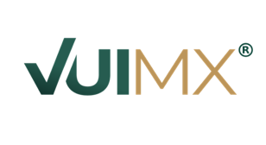
Streamlined Investment
Through Digital Tools: Single
Window for Investors (VUI MX)¹
Through VUI MX, Mexico follows international best practices to attract investment,
boost competitiveness and create a better business climate in our country.
VUI MX provides:
  Transparency and legal certainty in rules and procedures
  Streamlined processing times for investors
  Support throughout the investment process
  Step-by-step guide on general procedures by economic sector.
  Provides key information about investing in Mexico.
Quick response and guidance for all investment setup procedures.
1/ VUI MX: https://ventanillaunica.economia.gob.mx/

Slide 49

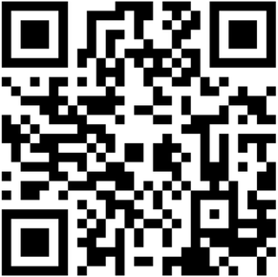
GatewayMX
GatewayMX is an initiative of Mexico's Foreign Ministry, designed to bring together key platforms, tools, and resources that support international investment and trade. It serves as a curated access point for navigating Mexico's dynamic and evolving economic landscape.
Whether you are an investor seeking new markets or a business aiming to expand through trade, GatewayMX offers centralized guidance, actionable intelligence, and strategic connections to help you make informed decisions and seize opportunities.
1/ GatewayMX: https://portales.sre.gob.mx/index.php/gateway-mx

Slide 50
What’s next?
Introductory meeting
Investment project form
Wait for confirmation
and follow-up
  Schedule an initial meeting with a Mexican embassy or consulate to present your investment project or to receive information on Mexico's competitive advantages and available tools for foreign investors.
  Based on the information you provide, the embassy or consulate will fill out the Investment attraction technical form, which will allow your project to be channeled to the appropriate authorities.
  Once your project information has been submitted, you will receive confirmation that it has been shared with the Foreign Ministry (SRE).
  You will then be informed of the next steps and the institutional pathway tailored to your project's profile—taking into account the strategic sector, maturity level, and any logistical, regulatory, or technical considerations.
  Depending on your project's characteristics, coordinated actions may include: technical follow-up, exploratory missions or site visits, B2B meetings or joint activities with the Ministry of Economy, local authorities, promotion agencies, business chambers, or other relevant stakeholders.

Slide 51
Mexico:
Where Opportunity Meets Profit
July 2025

